Slide 1
Talented Transformations
Lesson 3

Slide 2


Review

Slide 3
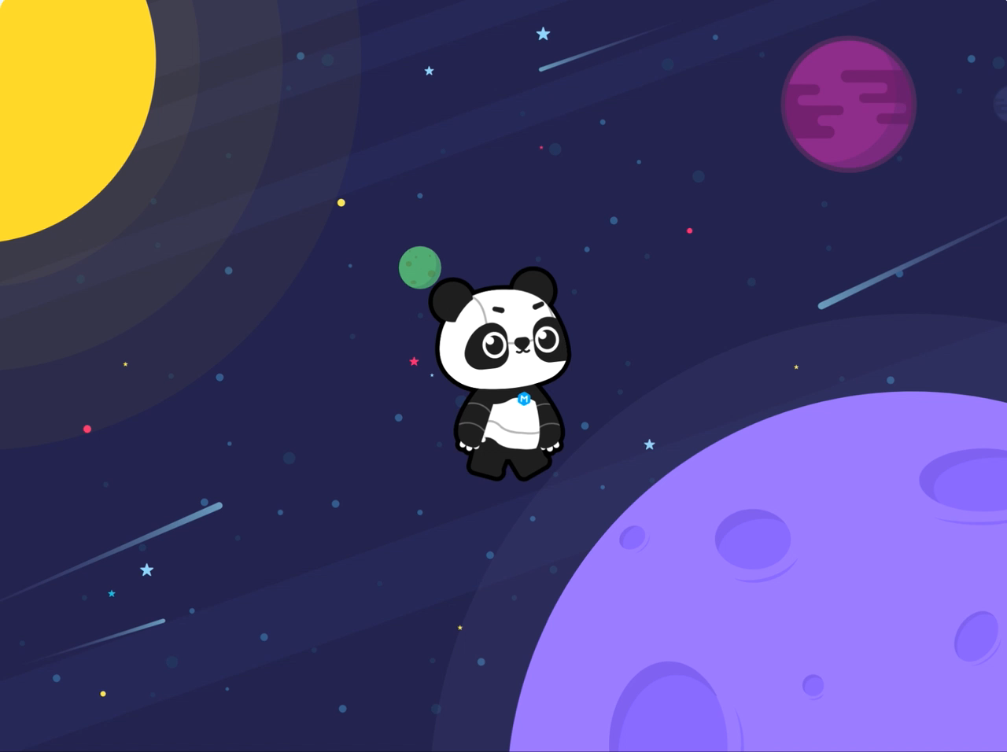

Slide 4
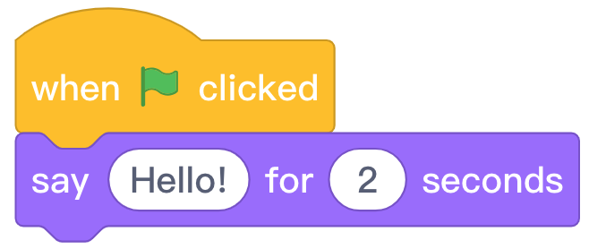
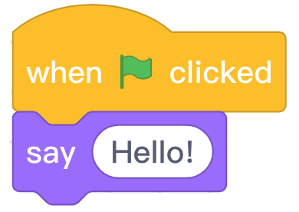
Review

Slide 5
Review
Program | Effect
After the green flag is clicked, the sprite says "Hello!" for 2 seconds.
After the green flag is clicked, the role says "Hello!" continuously.

Slide 6
Example

Slide 7
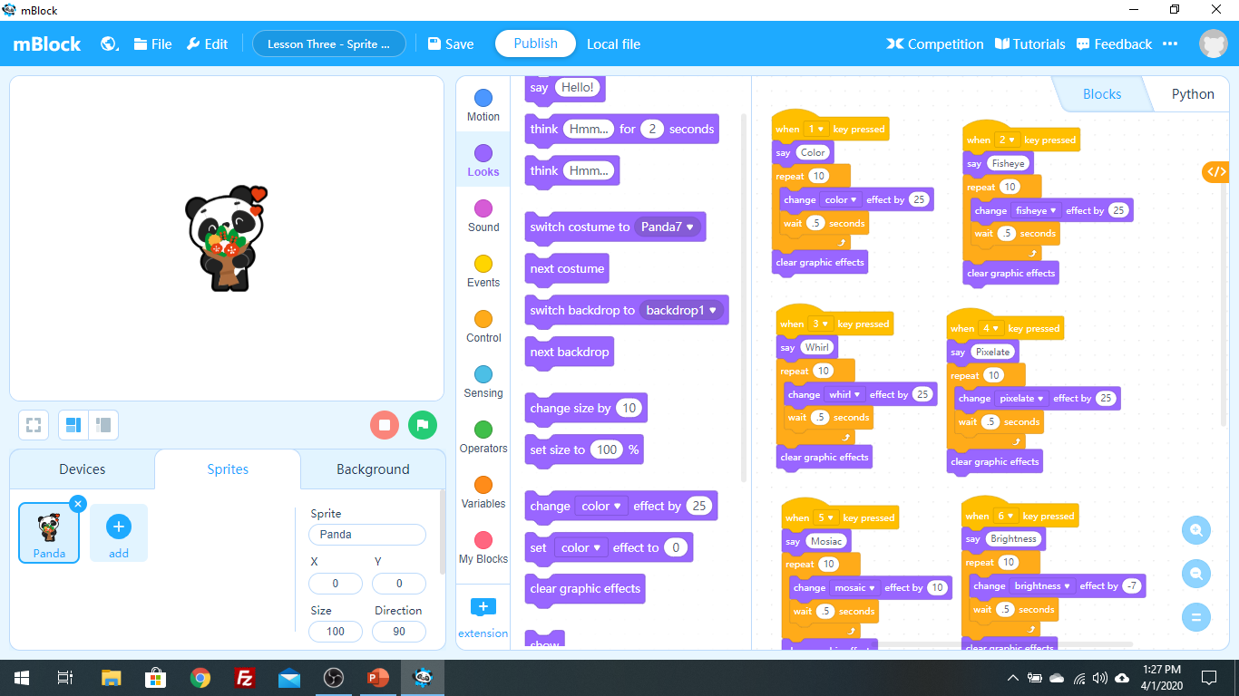

Slide 8
Hands-on

Slide 9

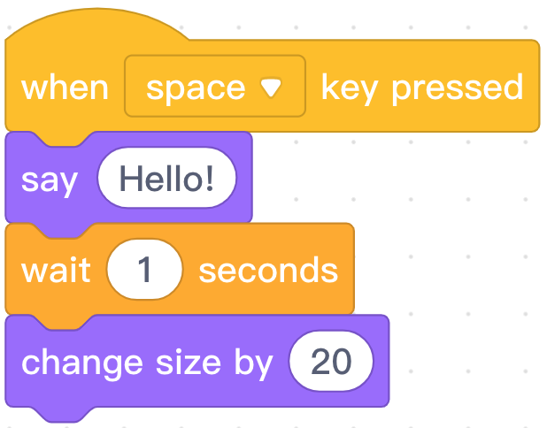
"Event“
In a program, it is the start signal for subsequent actions.

Slide 10
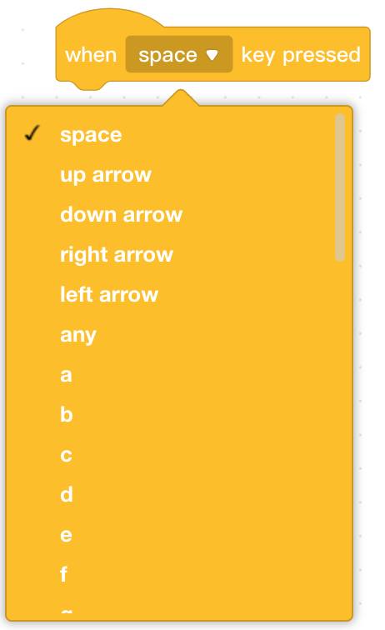


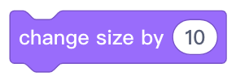
Programming Knowledge
Block area | Block | Function
Press a key on the keyboard to start the subsequent action.
Change the size of the sprite. When the value is positive, the role will become larger and vice versa.

Slide 11
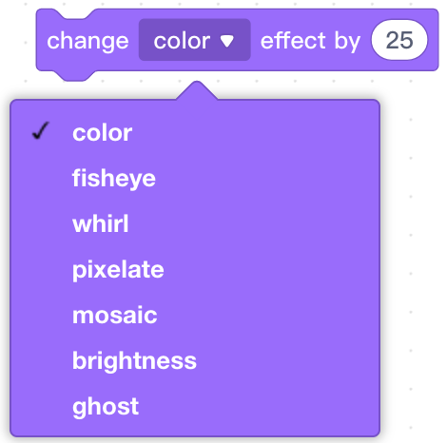
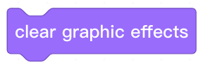
Programming Knowledge
Block area | Block | Function
Change the special effects of the sprite. When the value is positive, the graphic effects will be strengthened and vice versa.
Clear the set graphic effects and restore the initial state of the sprite.

Slide 12
Set the Sprite’s Transformation Effect

Slide 13

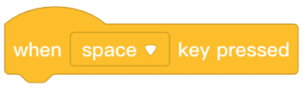
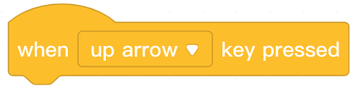

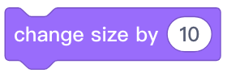
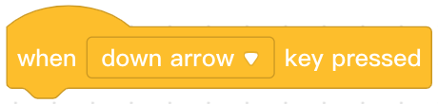
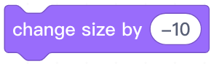
Step 1: Open the mBlock software. Create a new file and click the Sprites tab in the Stage Area to ensure that we are programming the Panda sprite.
Step 2: Find and select from the Block Area. Click and drag the block to the Script Area. Click the arrow next to “space” and change it to
.
Step 3: Find and select from the Block Area. Click and drag the
block to the Script Area and attach it beneath the block.
Step 4: Repeat steps 2 and 3 using the following blocks:

Slide 14
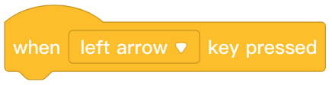
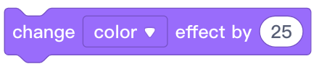
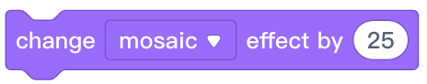
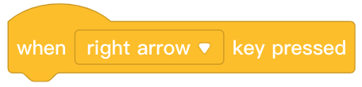
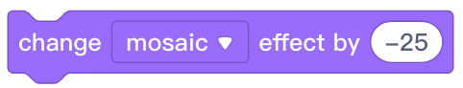
Step 5: Find and select from the Block Area. Click and drag the block to the Script Area. Click the arrow next to “space” and change it to
.
Step 6: Find and select from the Block Area. Click and drag the
block to the Script Area and attach it beneath the block. Click the arrow next to “color” and change it to .
Step 7: Repeat steps 5 and 6 using the following blocks:

Slide 15
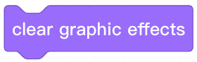
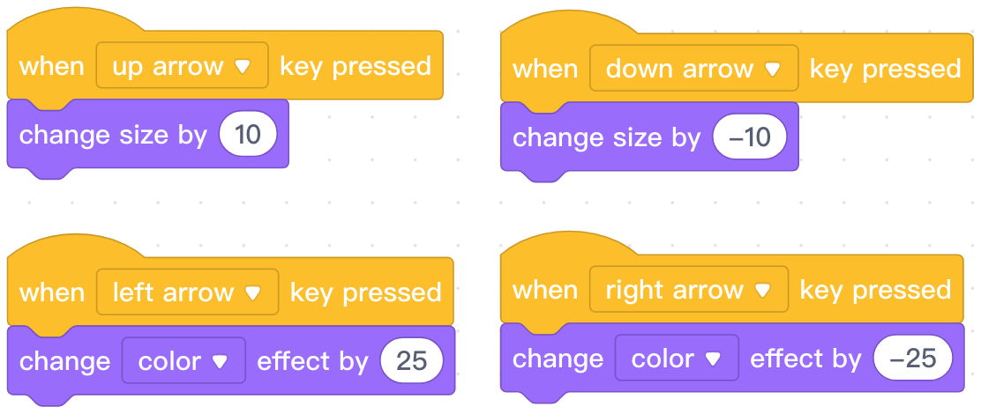
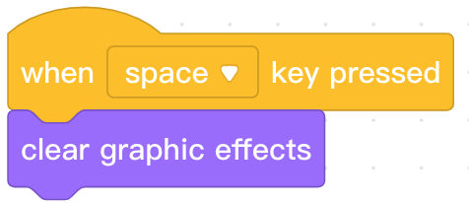
Step 8: Find and select from the Block Area. Click and drag the block to the Script Area
Step 9: Find and select from the Block Area. Click and drag the
block to the Script Area and attach it beneath the block.
Step 10: Press the arrow and space keys on the keyboard to observe Panda’s
transformations.

Slide 16
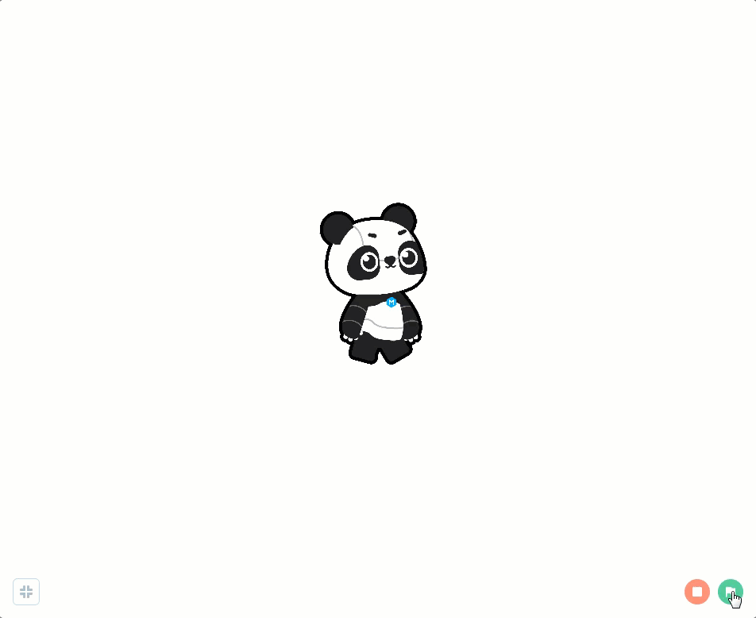
Notes:
教师：播放案例视频，回顾案例效果

Slide 17
Try It

Slide 18
Independent Practice
Panda’s Transformation
Panda is excited to showcase a variety of transformations at the upcoming party.
Create a program that does the following:
Includes an appropriate background for the party.
Includes 3 transformation effects.
Triggers transformations using the ↑, ↓, ←, → , W, A, S, and D keys.
Triggers a reset of the effects and size using the space key.

Slide 19
Extension
Challenge students with remaining time to do one or more of the following:
Trigger multiple transformations with the same event.
Add say blocks to program Panda to say something during the transformation showcase.
Notes:
对学有余力的同学，可以为Panda设计更多的特效，增加Panda的变身本领。

Slide 20
Let’s Share!

Slide 21
Share Your Project

Slide 22
Review

Slide 23
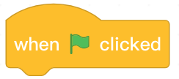
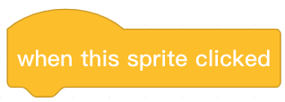
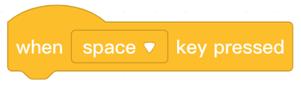
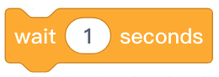
1. Which of the following options is not an event block?
A.
B.
C.
D.
Notes:
Answer: D

Slide 24
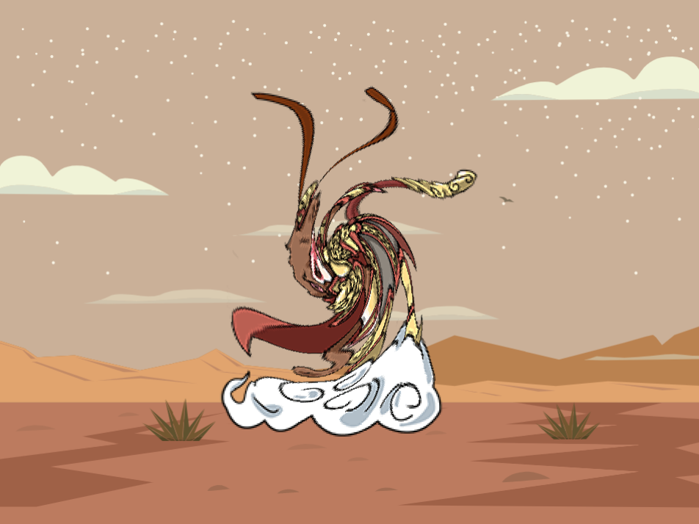
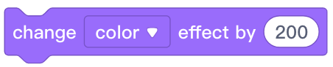
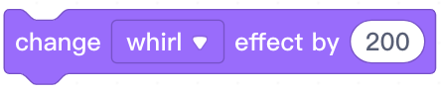
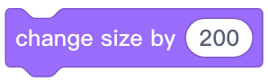

2. Which of the following blocks can make a sprite look like the figure in the picture?
A.
B.
C.
D.
Notes:
Answer: B

Slide 25
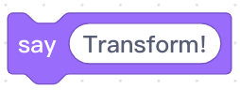
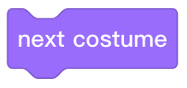
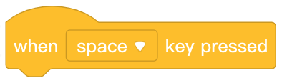
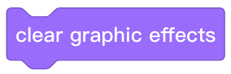
3. Which of the following blocks can make a sprite return to its original appearance?
A.
B.
C.
D.
Notes:
Answer: D

Slide 26
Thank you!

